Slide 1



Heart Stroke Prediction using Machine
Learning Technique(KNN)
Bhairav Phukan
Sayantan Sarkar
Grahil Agarwal
RA1911033010131 (M1)
RA1911033010150 (M1)
RA1911033010152 (M1)

Slide 2

01
INTRODUCTION
PROCEDURE AND METHODOLOGY
02
03
ALGORITHMS TESTED
TABLE OF
CONTENTS
PERFORMANCE ANALYSIS
04
05
RESULT
ADDITIONAL WORK
06
07
CONCLUSION
Notes:
Photo by Sean Pollock on Unsplash

Slide 3
INTRODUCTION
Data is a crucial aspect of every industry and organisation. With exponential amounts of data being produced every day, data science has experienced massive growth and found applications in several industries. Historically, the healthcare sector has been an early adopter of technological advancements and benefited greatly from them. Traditionally, diagnosis and treatment of diseases solely relied on the professionals' discretion.
01
02
Several life-threatening ailments have been cured by early diagnosis or by identifying patterns discovered from extensive research. Data-driven decision-making increases the quality of healthcare services, especially in implementing preventive measures for a medical emergency.
This is evident from the detailed study on stroke, a medical emergency that arises due to a lack of blood flow to critical organs due to a ruptured blood vessel or blockage.
It has become imperative to establish an efficient system that inculcates the various factors known to have an impact on the heart and, based on the observed patterns, predict a person's vulnerability to such life-threatening diseases.
03

Slide 4
PROCEDURE AND METHODOLOGY
04
Proposed Model
Data Pre-processing
Using Supervised ML models to predict the risk of heart stroke
Transforming the raw data into an easier format to work on
01
03
System Methodology
Dataset Description
Describing the workflow
Describing the attributes of the dataset
02

Slide 5
PROPOSED STATEMENT / MODEL
To implement Heart Stroke Prediction, a system can be established using Machine Learning, a subset of Artificial Intelligence capable of processing copious amounts of data in a short period and building a comprehensive view of the data that assists in discovering patterns and providing practical insights.
01
02
Based on the data and its patterns, a model trained by Machine Learning concepts can predict the probability of occurrence of a heart stroke in a patient based on their personal and medical history. The accuracy of this prediction is a crucial factor for successful early diagnosis.
This proposed research aims to conduct a comprehensive analysis of the supervised learning algorithms, their accuracy and the pros and cons of using them to design an effective Heart Stroke Prediction model.
03

Slide 6
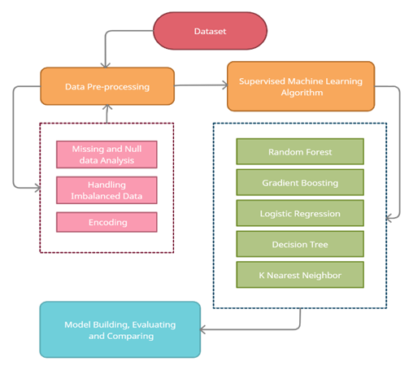
SYSTEM METHODOLOGY
An appropriate dataset was collected from Kaggle.com for model training among the pre-existing datasets available online.
The next step is data pre-processing which includes handling missing values, Null values, imbalanced data, and label encoding.
The pre-processed data attributes were then visualised to check for correlations between the different features in our dataset
This was followed by model training. After building five different models, their accuracy metrics: Accuracy Score, Precision Score, Recall Score and F1 Score were evaluated and compared.
The comparison of the accuracy metrics gives the best model.

Slide 7
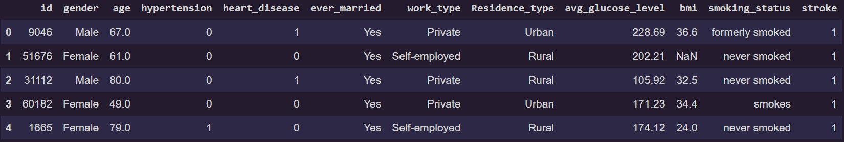
DATASET DESCRIPTION
ID: It is numerical data that refers to the person's identity.
Age: It is numerical data that refers to the person's age.
Gender: It is categorical data that refers to the person's gender.
Hypertension: It is numerical data that indicates the history of hypertension of the person.
Work type: It is categorical data that describes the person's employability scenario.
Residence type: It is categorical data that describes the person's residential area.
Heart disease: It is numerical data that indicates the person's prior history of heart diseases.
Average glucose level: It is numerical data that indicates the person's average glucose levels.
BMI: It is numerical data that indicates the person's body mass index.
Ever married: It is categorical data that refers to the person's marital status.
Smoking Status: It is categorical data that indicates the person's smoking history.
Stroke: It is numerical data that indicates whether a person has previously suffered from a stroke.

Slide 8
DATA PRE-PROCESSING
Binary Features
Continuous Features
Categorical Features
One hot-encoding is used to convert the features Gender, Marital status and Residential area into binary (0 or 1) values.
Gender: 0 represents female, and 1 represents male.
Marital Status: 0 represents unmarried, and 1 represents married.
Residential Area: 0 represents rural area, 1 represents urban area
A function has been devised to divide the features of Average Glucose level, BMI and Age into constant range
Age: Age is divided into ranges of 0-19 years, 20-39 years, 40-59 years and above 60 years.
Average Glucose Level: The glucose levels have been divided into blocks of 25% each, starting from below 25%, 26-50%, 51-75% and above 75%.
BMI: The BMI levels have been divided into blocks of 25% each, starting from below 25%, 26-50%, 51-75% and above 75%.
First, we implement One-hot encoding on the previously transformed continuous features.
These are then mapped into matrices of binary values, making it easier to process the data.
The BMI feature has 101 null values; since the data is typically distributed, the null values are replaced with the mean of the BMI as the 50% line is similar to the mean.

Slide 9
ALGORITHMS
01
LOGISTIC REGRESSION
02
GRADIENT BOOSTING
03
RANDOM FOREST
04
DECISION TREE
05
K NEAREST NEIGHBOURS
Notes:
Photo by Sean Pollock on Unsplash

Slide 10
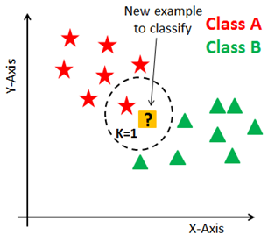
K-NEAREST NEIGHBOUR
It works well with a small number of input variables and small datasets.
It has excellent predictive power and high-performance accuracy since it is robust to noisy data.
Any new structure/ data can be added seamlessly without affecting the algorithm's accuracy, making it suitable for multi-model classes.
It is a simple algorithm and easy to implement and interpret since it employs instance-based learning (Lazy Learner), requiring no training period.
KNN possesses a variety of distance metrics- therefore, we can choose which is best suited for our application.
This algorithm is sensitive to outliers or complex features, and as data increases, the speed at which calculations are done rapidly decrease. Limitation of memory is another drawback.

Slide 11
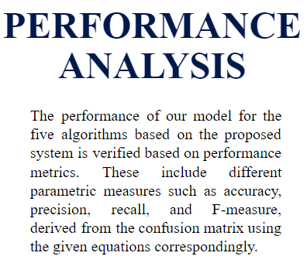
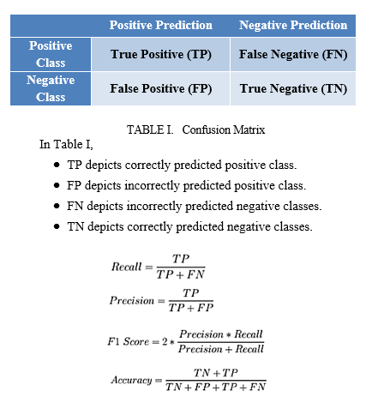
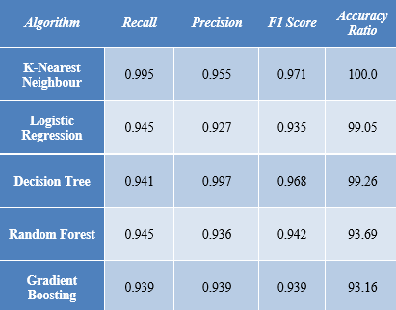

Slide 12
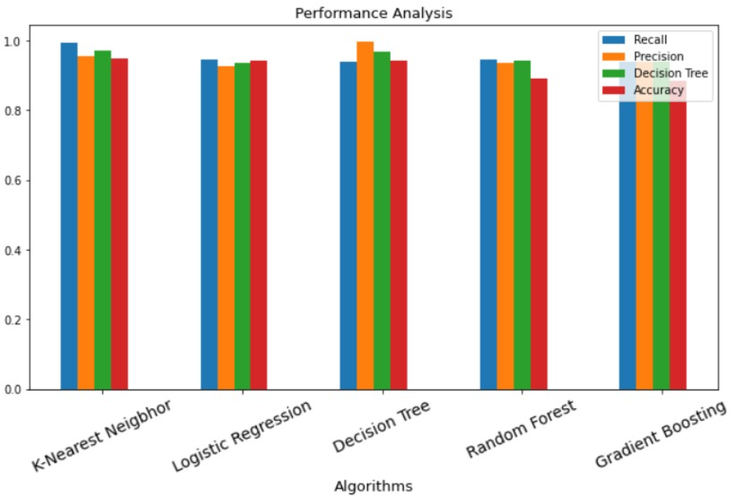
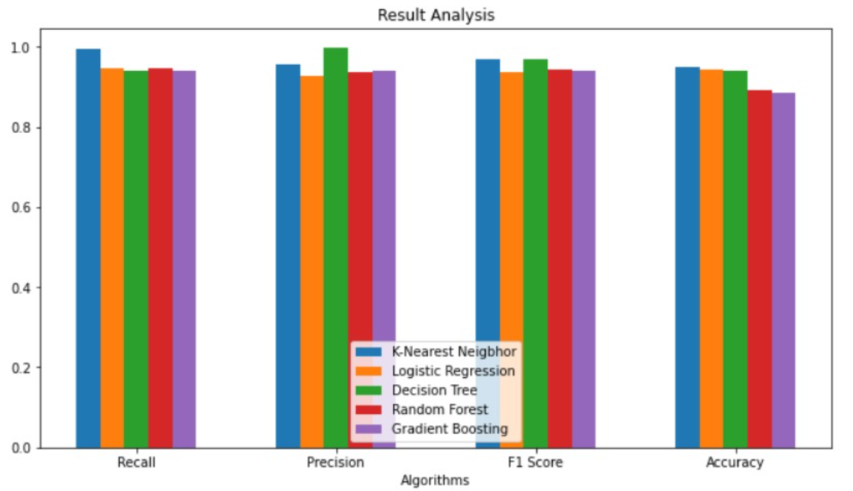
RESULT

Slide 13
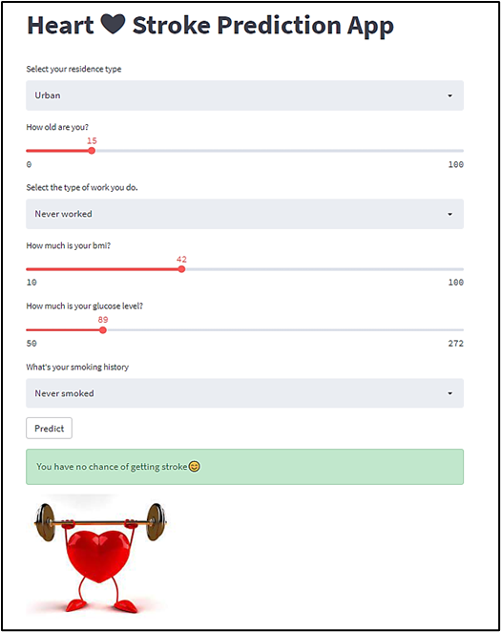
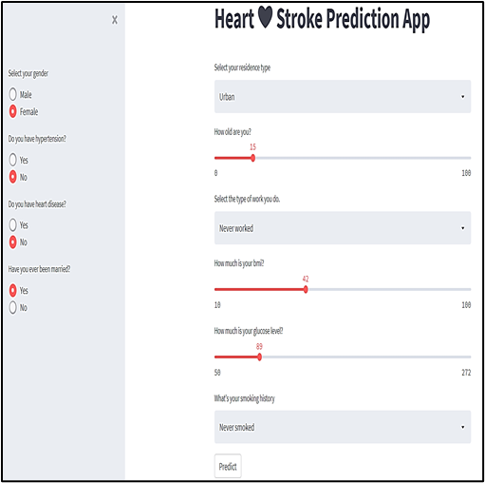
ADDITIONAL WORK

Slide 14
CONCLUSION
01
Stroke is a severe medical illness; an early diagnosis of the same can aid in the prevention of life-threatening developments. The involvement of a machine learning model can aid in the early detection of the probability of a stroke.
02
Analysis and evaluation of several prediction models showed adequate accuracy in identifying patients at the risk of a heart stroke. Through extensive research involving the models used, we conclude that the K-Nearest Neighbour algorithm gives the highest accuracy in our dataset when compared against Random Forest, Decision Tree, Logistic Regression and Gradient Boosting. The result further implies that adding new data into our dataset will result in similar accuracy scores.
03
This study uses a web application to implement the machine learning model in a user-friendly format and help demonstrate the estimation of heart stroke risk using a prediction model. As a result, it encourages medical users to increase their motivation for health management and make adjustments in their health behaviours.

Slide 15

Thank
You!

